Slide 1
CS 210 Group Project
Deniz Durmuşoğlu 28972
Berkant Umut Özbölük 29577
Gülnihal Seda Erdemli 29057
Serra Yakupoğlu 31106
Yağmur Dolunay 29323

Slide 2
To what extent does the socio-economic conditions of households determine their cigarette consumption behavior?

Slide 3
Collecting The data

Slide 4
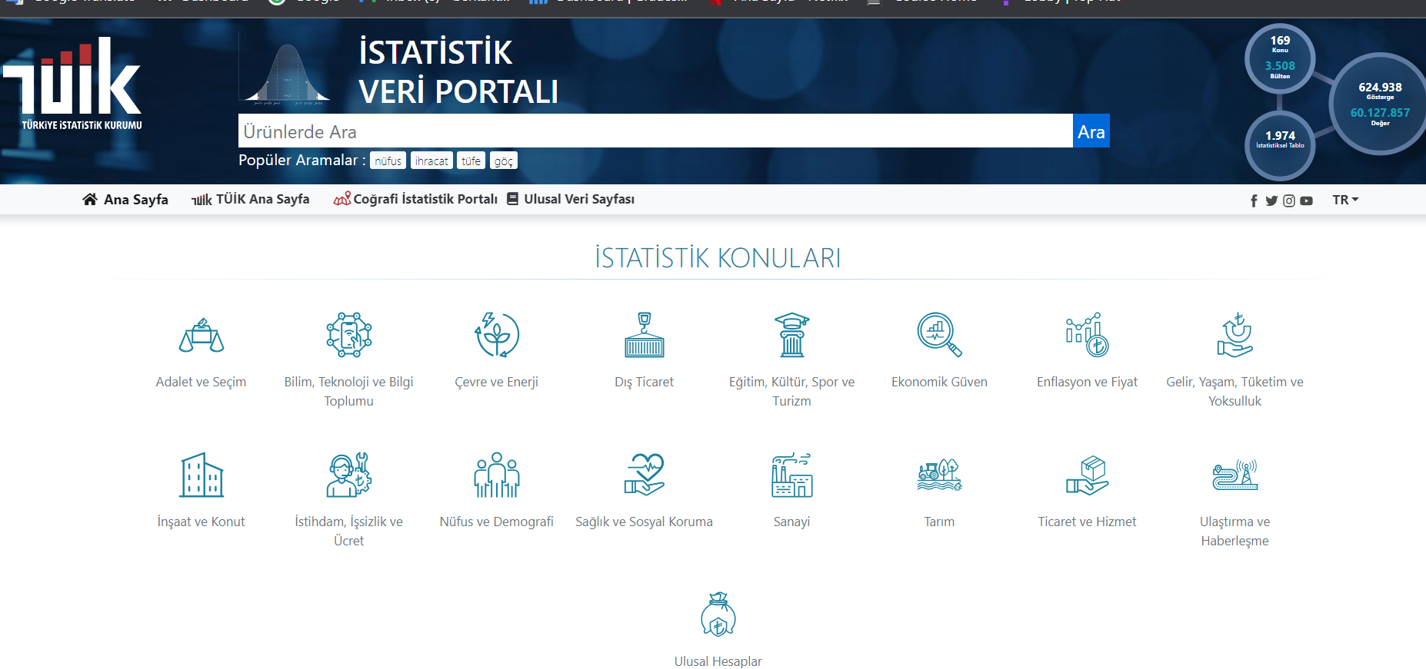
Why we chose Tuik to collect data?
Reliable
Easy to access
Suitable for use
Ethical reason
COICOP(Classification of Individual Consumption by Purpose)

Slide 5
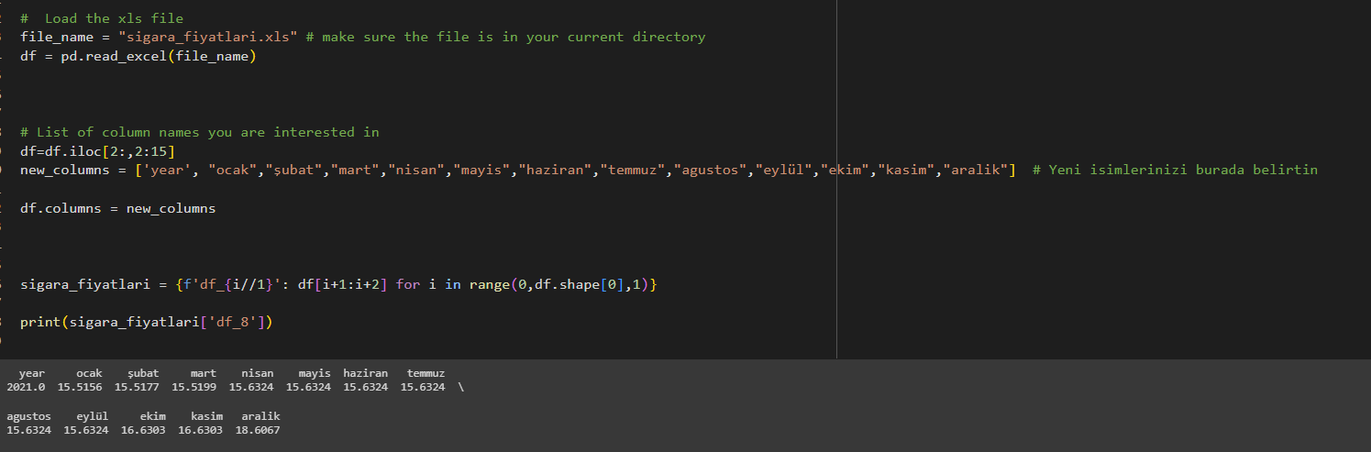
How we cleaned and formed the data?

Slide 6
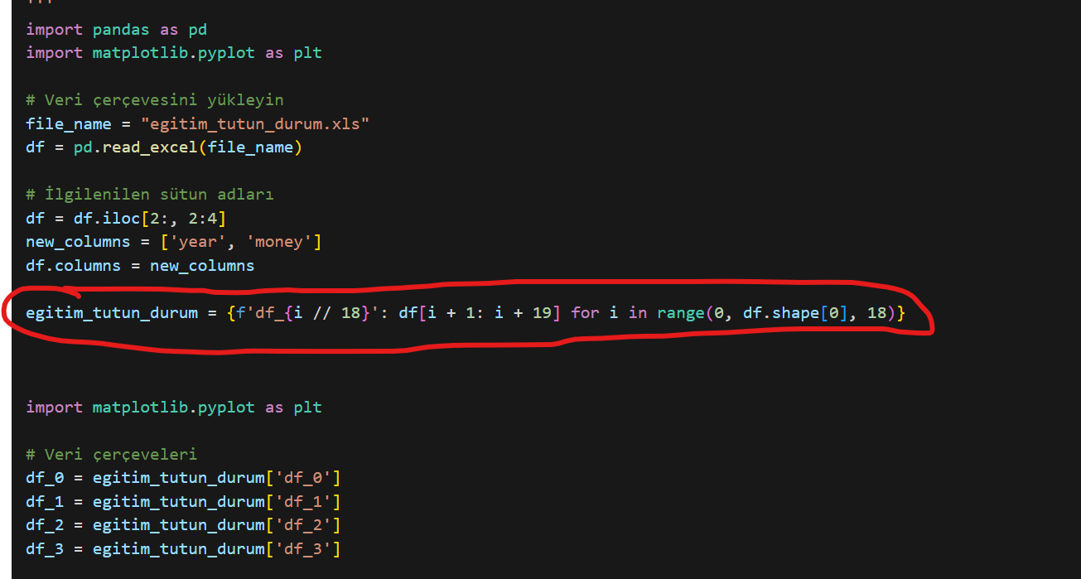
Some difficulties we faced after collecting data
→Ready to use for graph
→Ready to use for data analysis

Slide 7
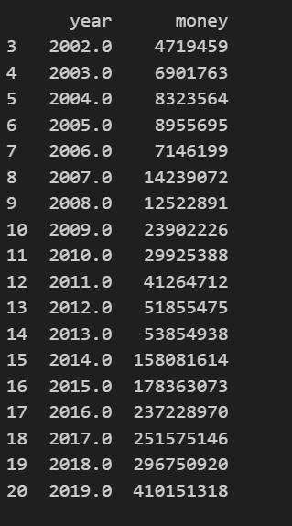
Final shape of data
→number of rooms in house - tobacco use
→education level - tobacco use
→income level - tobacco use
→household size - tobacco use
→status at work - tobacco use
→home ownership - tobacco use
→etc.

Slide 8
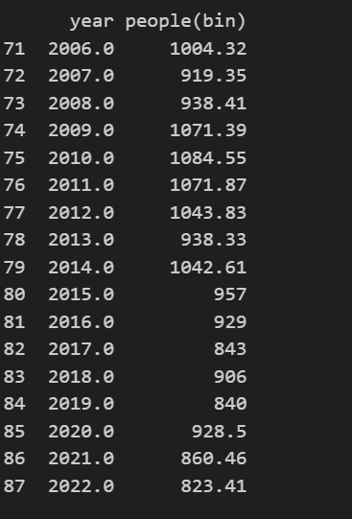
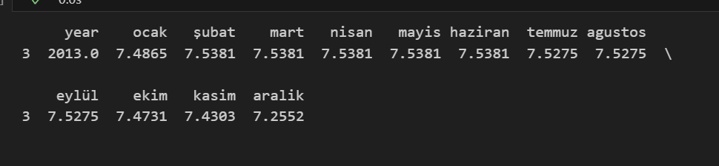
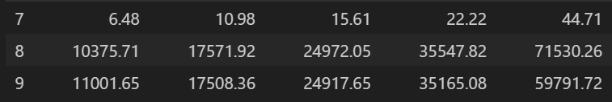
Other final shape of data

Slide 9
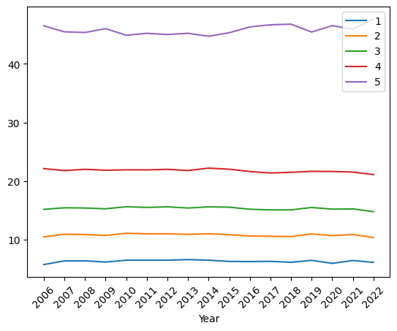
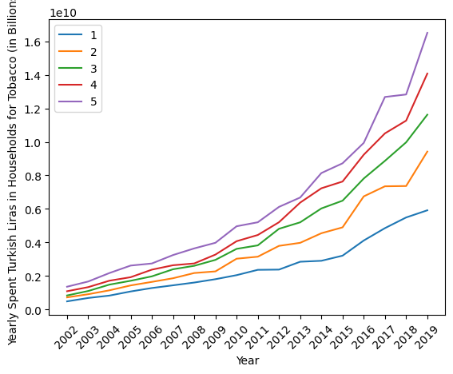
Data Visualization
Income Types: Household Disposable Income and 20% Income Groups
Yearly Spent Turkish Liras in Households for Tobacco (in Billions)

Slide 10
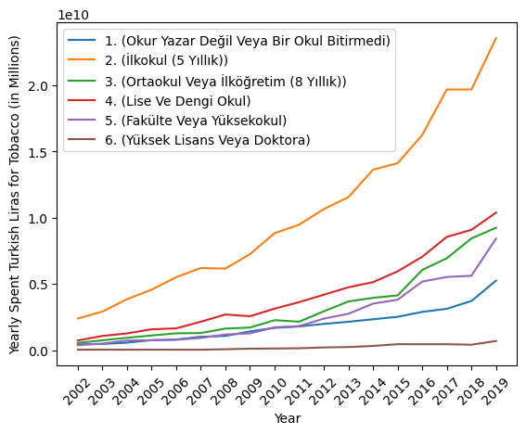
Total Tobacco Expenditures by Educational Status of Household Head For 1 Year

Slide 11
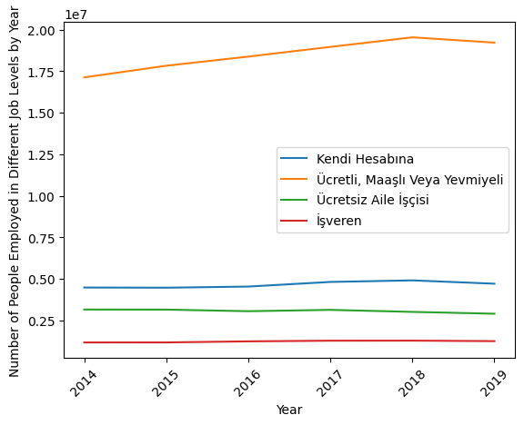
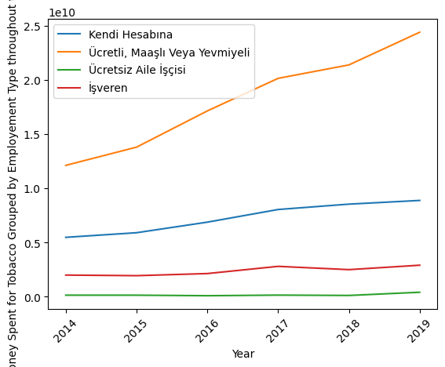
Number of People Employed in Different Job Levels by Year
Money Spent for Tobacco Grouped by Employement Type Throughout the Years

Slide 12
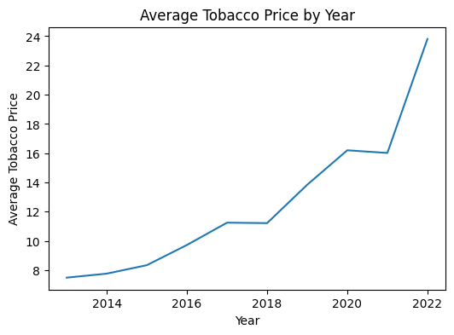

Slide 13
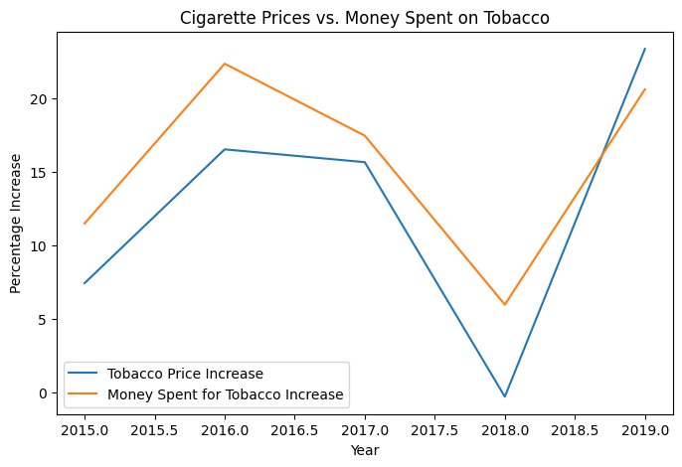
This means the proportion of the population that purchases tobacco in Turkiye, was not affected by the increases in prices.
Correlation: 0.9350885565137862

Slide 14
Berkant regresion

Slide 15
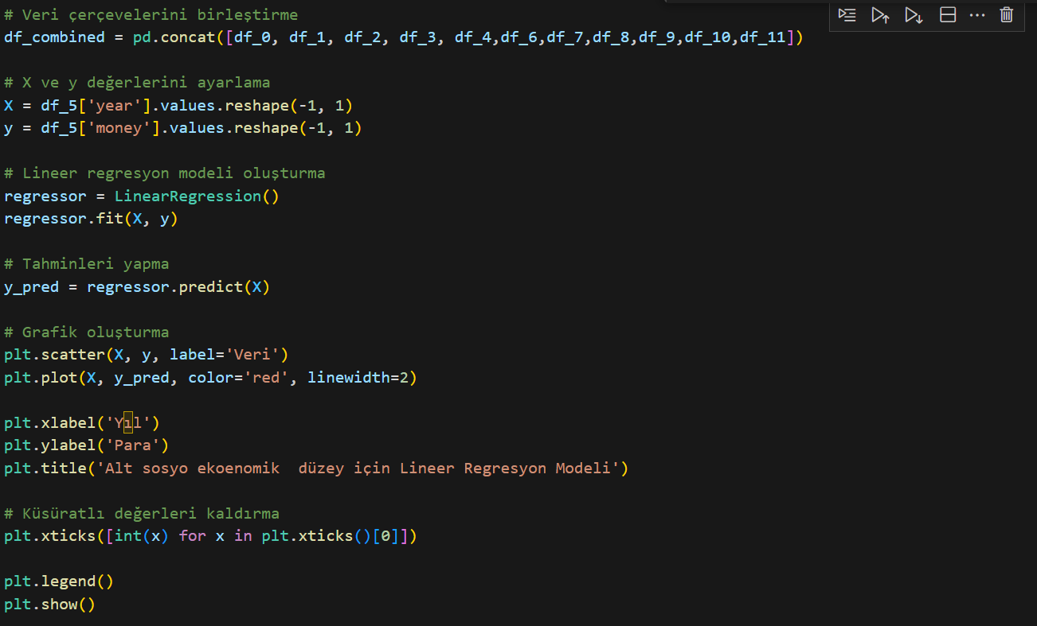
The base code we developed for linear regression
→ merging features to conclude meaningful conclusion data
→regression graf demonstrated
→MSE calculated

Slide 16
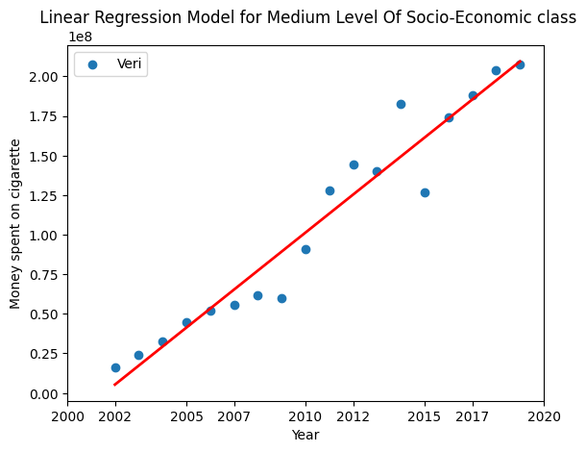
Linear Regression Model For Medium Socio-Economic Class
We trained the data using the medium-class’s aspects, such as high school graduates, daily labor etc.

Slide 17
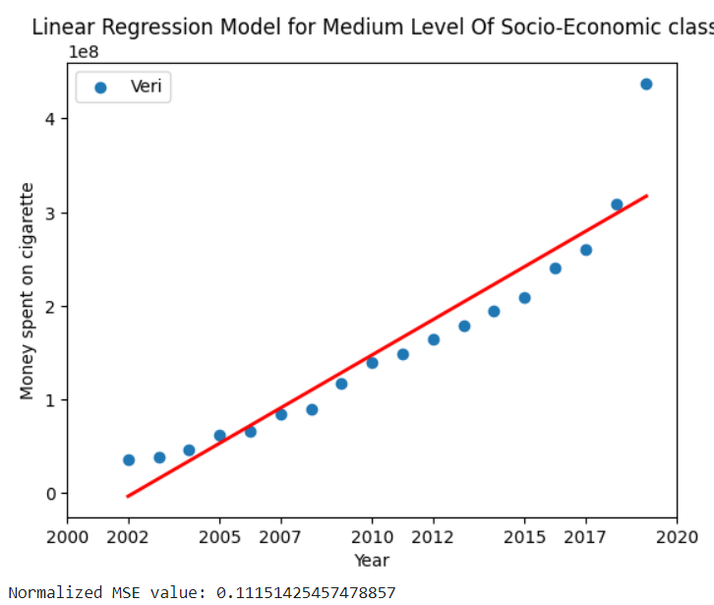
Linear Regression Model For Medium Socio-Economic Class
We tested the model with an upper class’ aspect
which is being an employer and the owner of the job.
As we can see, the MSE value is really high.

Slide 18
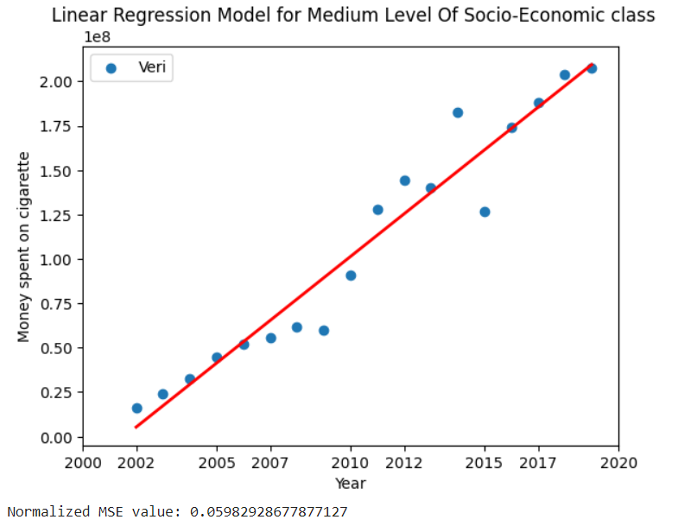
Linear Regression Model For Medium Socio-Economic Class
And, after that we tried with a medium class’s
Aspect. As it can be seen the MSE value,
is decreased.

Slide 19
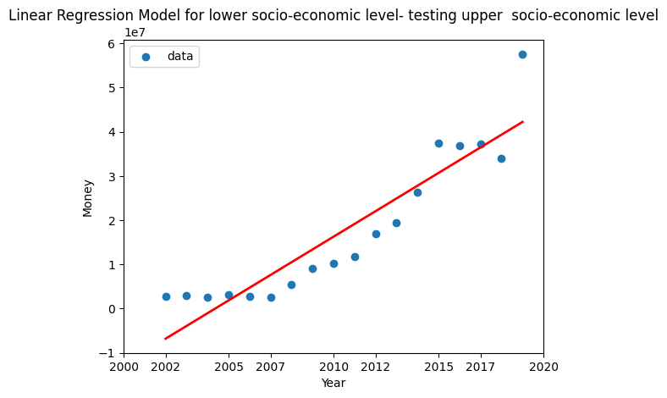

Linear Regression Model for lower socio-economic level- testing upper socio-economic level ( PhD graduate)
→ clearly undershoot
→acknowledges that the data is not at the lower socioeconomic level
→ also tobacco price increase :)

Slide 20
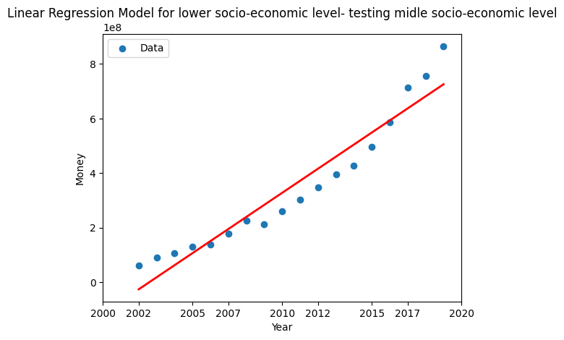

Linear Regression Model for lower socioeconomic level- testing middle socio-economic level ( high school graduate)
→ lower undershoot compare to Phd student
→acknowledges that the data is not at the lower socioeconomic level
→ also tobacco price increase :)

Slide 21
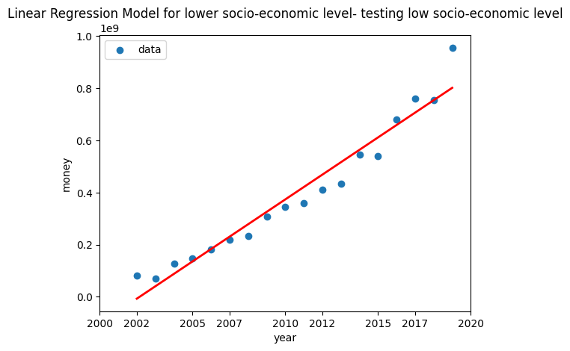

Linear Regression Model for lower socio-economic level- testing low socio-economic level (families with many children)
→ fit fata
→acknowledges that the data is at the lower socioeconomic level
→ also tobacco price increase :)

Slide 22
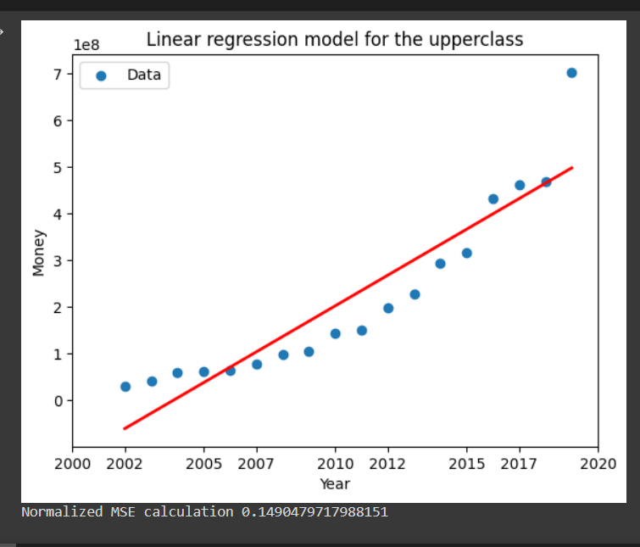
Regression for the upperclass of socio-economic status
Data frames:
-> University and masters degree
-> employer/job owner
->in the first 20%
->number of rooms in their house 5+
->the breadwinner between ages 44-65
->one person family or only spouses

Slide 23
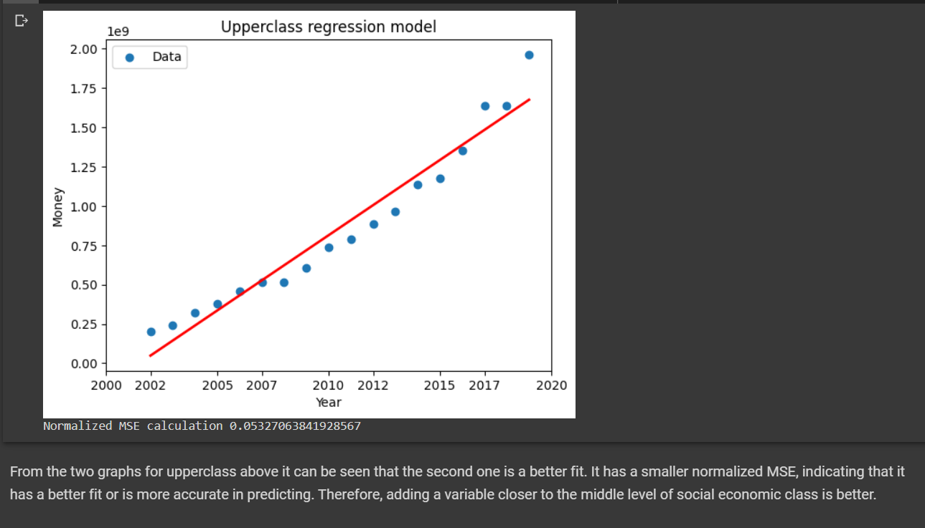
Second model for testing
Changing factors to fit the lowerclass such as adding illiterate people
The MSE decreases.
Proves our point!

Slide 24
Thank You For Listening
Deniz Durmuşoğlu 28972
Berkant Umut Özbölük 29577
Gülnihal Seda Erdemli 29057
Serra Yakupoğlu 31106
Yağmur Dolunay 29323

